Slide 1
Project `Alpha`
File One / File Two / File Three
User A Commit
Chg. File One
Del. File Two
Add. File Four
User B Commit
Chg. File One
Chg. File Two
Del. File Three
Add. File Five

Slide 2
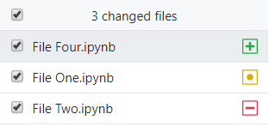
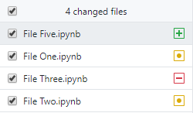

Slide 3
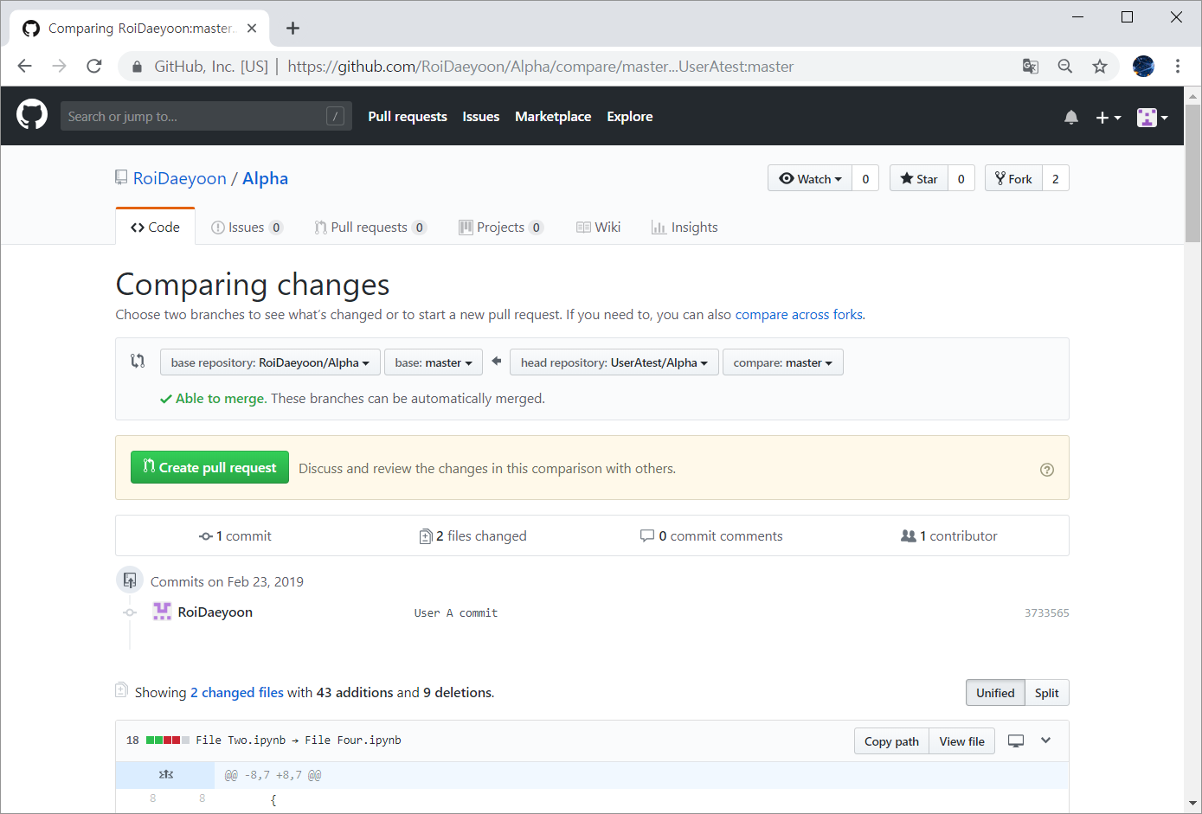

Slide 4
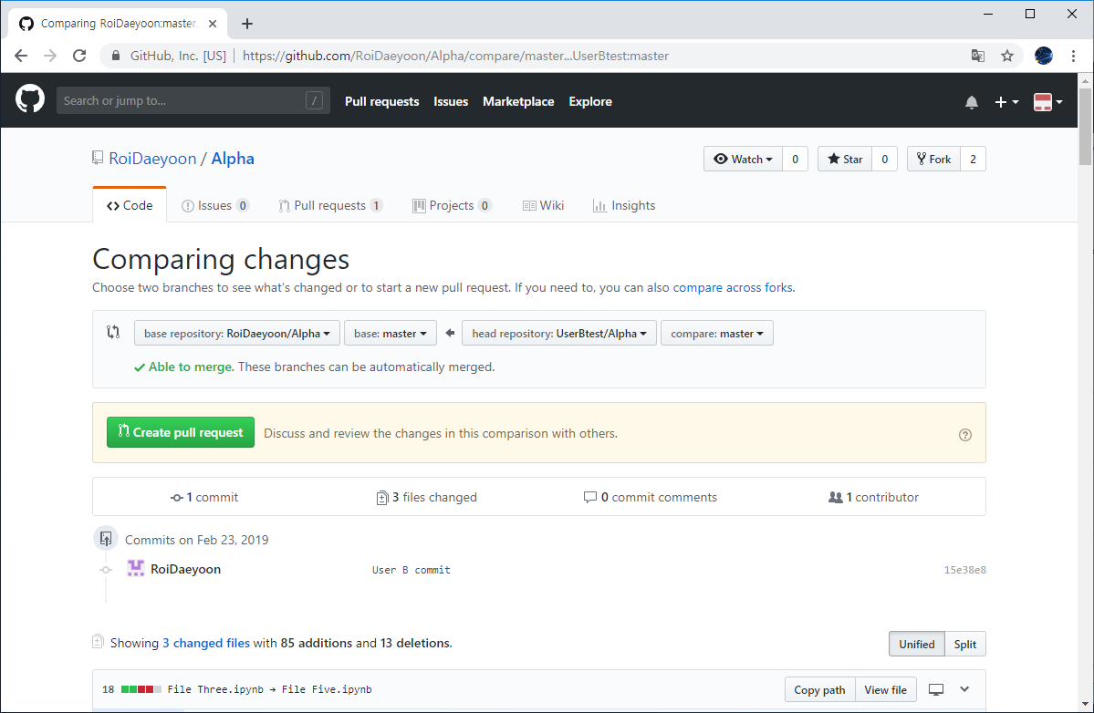

Slide 5
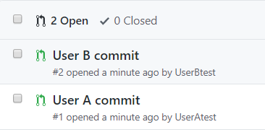

Slide 6
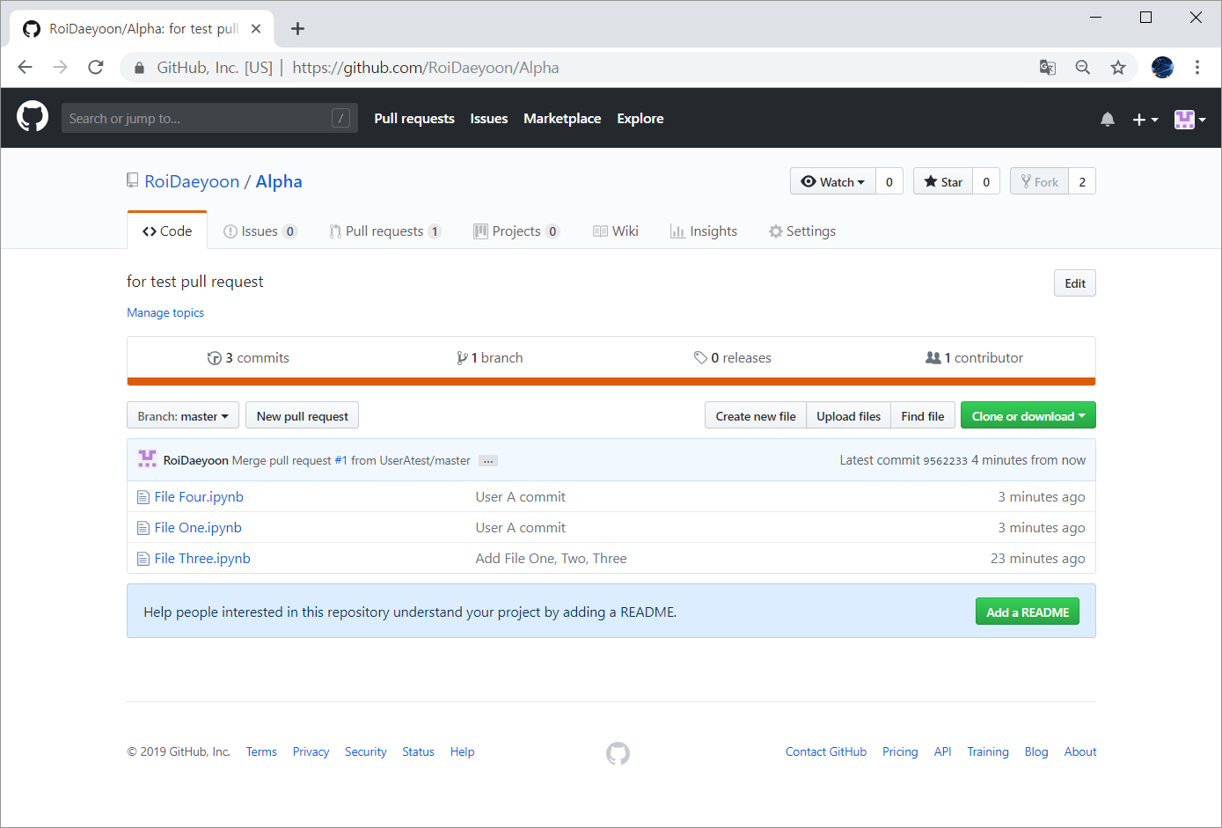

Slide 7
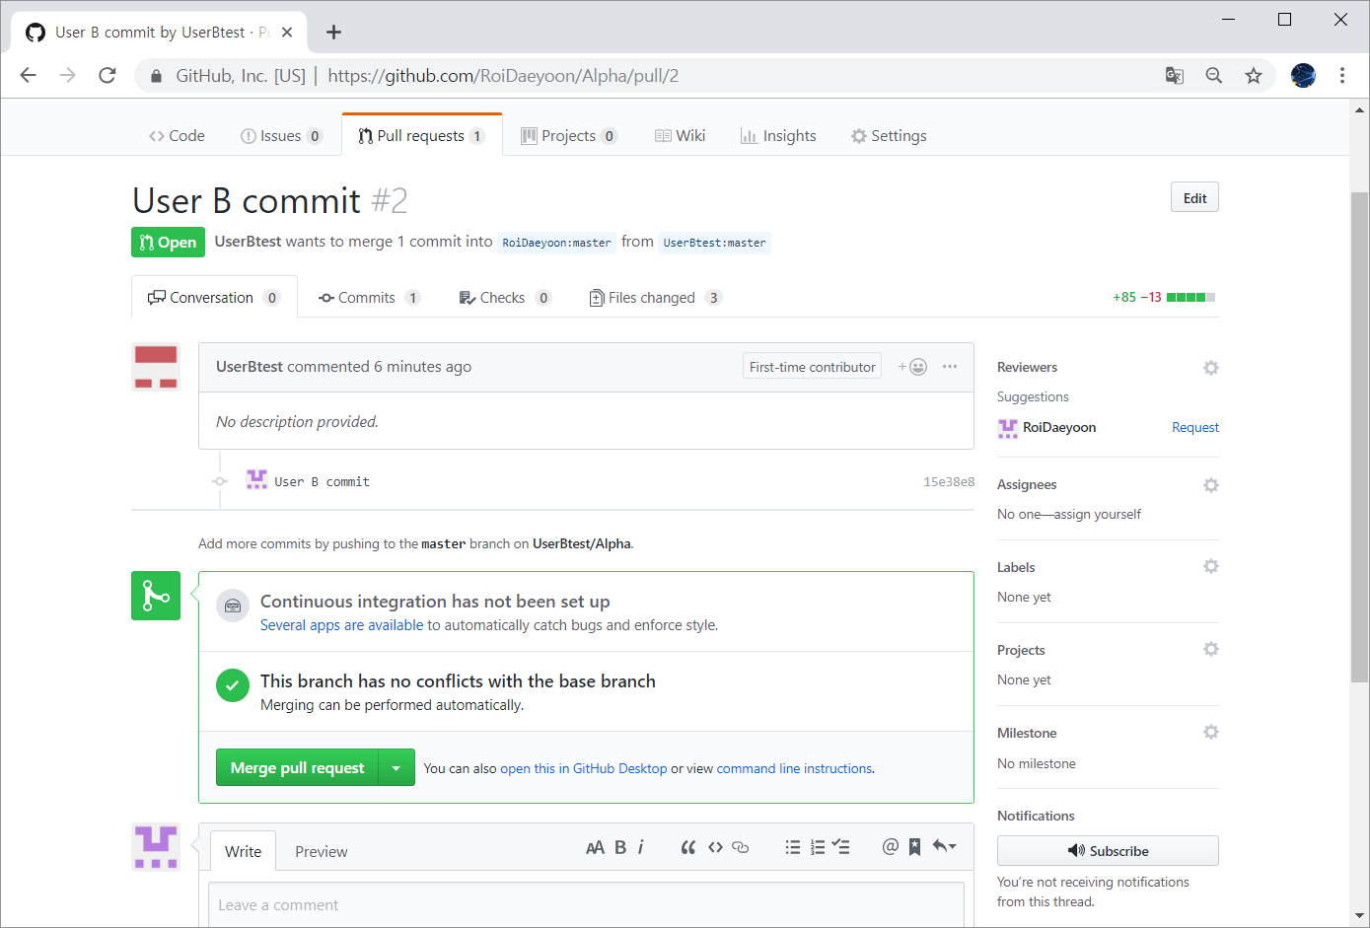

Slide 8
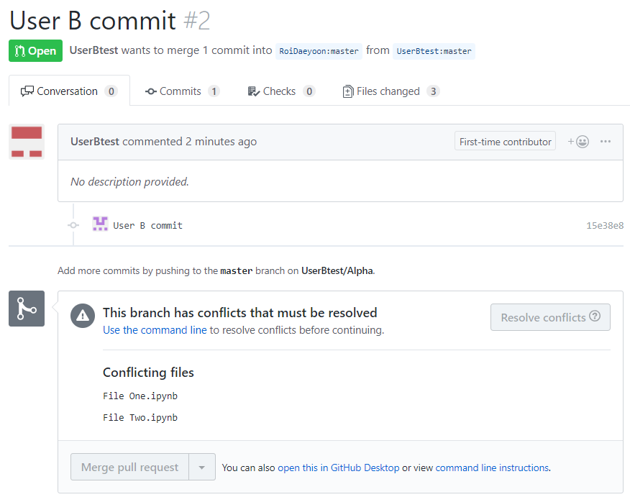

Slide 9
Project `Alpha`
File One / File Two / File Three
User A Commit
Chg. File One
Add. File Four
User B Commit
Chg. File One
Chg. File Two
Add. File Five

Slide 10
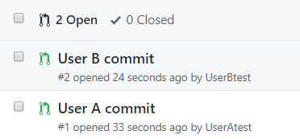

Slide 11
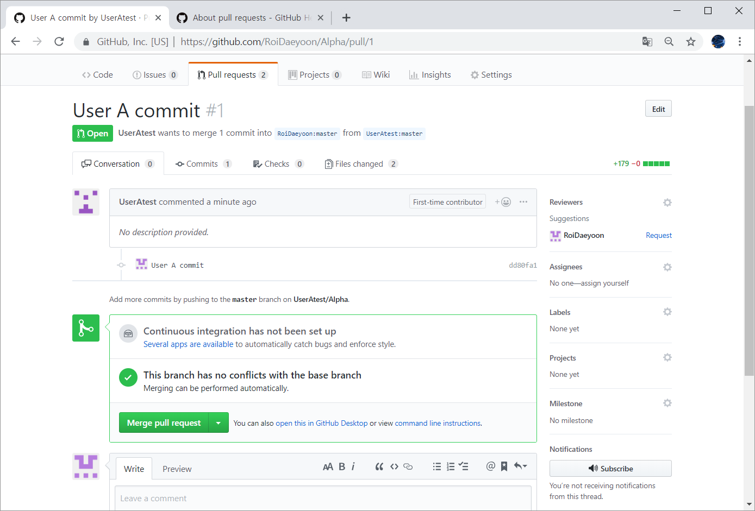

Slide 12
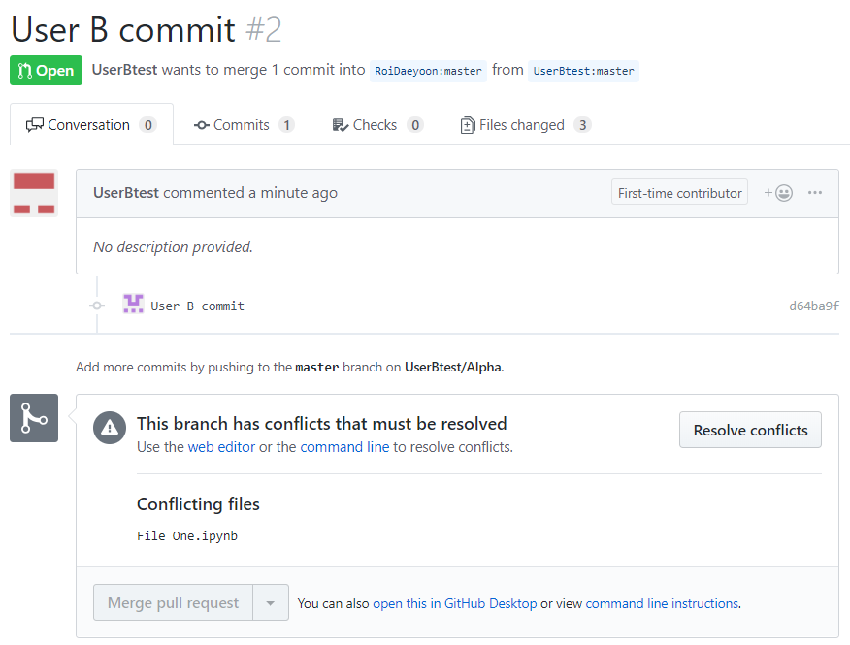

Slide 13
Project `Alpha`
File One / File Two / File Three
User A Commit
Add. File Four
User B Commit
Chg. File One

Slide 14
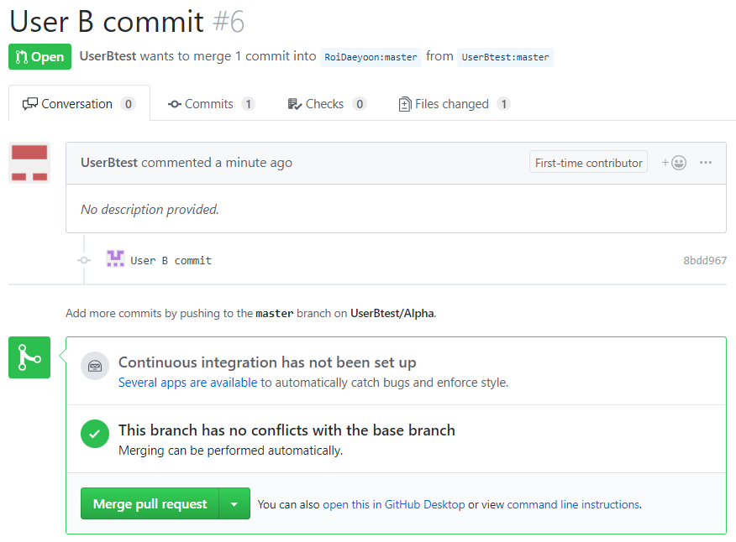

Slide 15
Project `Alpha`
File One
File Two
File Three
Project `Alpha`
File One’
File Three
File Four
User A Commit
Chg. File One
Del. File Two
Add. File Four
User B Commit
Chg. File One
Chg. File Two
Del. File Three
Add. File Five

Slide 16
Project `Alpha`
File One
File Two
File Three
Project `Alpha`
File One’
File Two
File Three
File Four
User A Commit
Chg. File One
Add. File Four
User B Commit
Chg. File One
Chg. File Two
Add. File Five

Slide 17
Project `Alpha`
File One
File Two
File Three
Project `Alpha`
File One
File Two
File Three
File Four
Project `Alpha`
File One’
File Two
File Three
File Four
File Five
User A Commit
Add. File Four
User B Commit
Chg. File One

